Slide 1
IA 222 (7.5 CREDITS)
CRYPTOGRAPHY
Lecture 1
Instructor: Mr. Wilbard G. Masue
Office: Academic block, 2nd Floor AB 207
Phone: 0764 222 232
Email: masueswily@gmail.com
19/03/2025
Mr. Wilbard G. Masue

Slide 2
Course Description
This course provides an explanation of basic contents of IT security. It focuses on the symmetric and public-key cryptography, cryptographic hash functions, authentication protocols, digital signatures and certificates. Course contains a survey of standards and covers legislative aspects of IT security. Course goal is introduction to algorithms and fundamentals of security protocols and techniques. The main goal of this subject is introduction to cryptography, steganography and watermarking.
19/03/2025
Mr. Wilbard G. Masue

Slide 3
Course Objective
Understanding the basic concepts and scientific thinking in cryptography.
Understanding the basic concepts of Steganography.
Understanding and apply some core cryptographic techniques and stenographic tools.
19/03/2025
Mr. Wilbard G. Masue

Slide 4
Course Outcomes
Explain the basic concepts of cryptography and steganography.
Apply some core cryptographic techniques and stenographic tools.
Describe a number of cryptographic protocols.
19/03/2025
Mr. Wilbard G. Masue

Slide 5
Course Contents
Cryptography: Concepts and Techniques, symmetric and asymmetric key cryptography, Substitution Techniques, Transposition Techniques, and Rotor Machines.
Stream ciphers: Random Generators, The One-Time Pad, Pseudo Random Permutations (PRP); Pseudo Random Functions (PRF); security against chosen plaintext attacks (CPA); nonce-based CBC encryption and nonce-based counter mode,RC4
Block ciphers: Early Block Cipher (Playfair), Feistel Ciphers
Symmetric key Ciphers: DES structure, DES Analysis, Security of DES, variants of DES, Block cipher modes of operation , AES structure, Analysis of AES , Key distribution Asymmetric key Ciphers: Principles of public key cryptosystems, RSA algorithm, Analysis of RSA, Diffie-Hellman Key exchange, Trapdoor One-Way Permutations
Message Authentication and Hash Functions: Authentication requirements and functions, MAC and Hash Funtions,
MAC Algorithms: Secure Hash Algorithm, Whirlpool, HMAC, Digital signatures, X.509, Kerberos Authentication, Digital signatures (definitions and applications)
Security at layers (Network, Transport, Application): IPSec, Secure Socket Layer(SSL), Transport Layer Security(TLS), Secure Electronic Transaction(SET)
Steganography, digital Watermarking
19/03/2025
Mr. Wilbard G. Masue

Slide 6
Reference Books
Cryptography and Network Security : Forouzan Mukhopadhyay, Mc Graw Hill, 2nd Edition
Principles of Information Security: Michael E. Whitman, Herbert J. Mattord,CENGAGE Learning, 4th Edition.
Cryptography and Network Security : William Stallings, Pearson Education,4th Edition
Information hiding: Steganography and Watermarking: attacks and countermeasures: Johnson, Neil; Duric, Zoran; Jajodia, Sushil (2001), Springer.
Cryptography and Network Security: C K Shyamala, N Harini, Dr T R Padmanabhan, Wiley India, 1st Edition.
Network Security and Cryptography: Bernard Menezes, CENGAGE Learning
Cryptography and Network Security : Atul Kahate, Mc Graw Hill, 2nd Edition
Principles of Computer Security: WM.Arthur Conklin, Greg White, TMH
Introduction to Network Security: Neal Krawetz, CENGAGE Learning
Handbook of Security of Networks, Yang Xiao, Frank H Li, Hui Chen, World Scientific, 2011.
Katz, J. and Lindell, Y. Introduction to Modern Cryptography, 2nd Edition
Stallings, W. Cryptography and Network Security: Principles and Practice, 6th ed. Upper Saddle River, NJ: Prentice Hall, 2013
19/03/2025
Mr. Wilbard G. Masue

Slide 7
Course Assessment
Tests (25 Marks)
Assignments & Labs (15 marks)
Any changes will be announced.
19/03/2025
Mr. Wilbard G. Masue

Slide 8
Module 1
Cryptography:
Concepts and Techniques,
symmetric and asymmetric key cryptography,
Substitution Techniques,
Transposition Techniques, and
Rotor Machines.
19/03/2025
Mr. Wilbard G. Masue

Slide 9
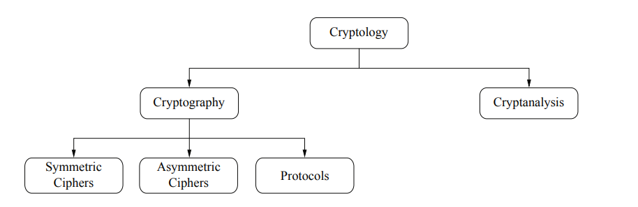
Basic Terminologies
19/03/2025
Mr. Wilbard G. Masue

Slide 10
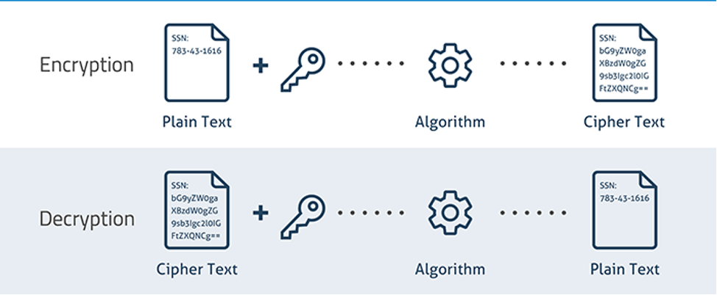
Basic Terminologies
19/03/2025
Mr. Wilbard G. Masue

Slide 11
Basic Terminologies
NIST defines Computer Security as the protection afforded to an automated information system in order to attain the applicable objectives of preserving the integrity, availability, and confidentiality of information system resources (includes hardware, software, firmware, information/data, and telecommunications).
Core objective element of security which are CIA triad and Information assurance pillars (known as security services):
  Confidentiality
  Integrity
  Availability
  Authenticity
  Non repudiation
19/03/2025
Mr. Wilbard G. Masue

Slide 12
Basic Terminologies
Cryptology is a science concerned with data communication and storage in secure and usually secret form.
  It encompasses both cryptography and cryptanalysis.
Cryptography is the science of secret writing with the goal of hiding the meaning of a message.
Cryptanalysis is the science and sometimes art of breaking cryptosystems.
  Cryptanalysis is of central importance for modern cryptosystems: without people who try to break our crypto methods, we will never know whether they are really secure or not.
  Steganography with the origin of Greek word means “covered writing”, means concealing the message itself by covering it with something else (watermarking).
19/03/2025
Mr. Wilbard G. Masue

Slide 13
Basic Terminologies
Where does the word cryptology come from?
Cryptology
  The term cryptology is derived from the Greek kryptós (“hidden”) and lógos (“science”) as a "science of secret characters or codes
Cryptography
  Is derived from the Greek kryptos, meaning “hidden” or "vault," and the suffix "-graphy" stands for "writing.“
Cryptanalysis
  From the Greek kryptós, "hidden", and analýein, "to analyze"
  Refers to the process of analyzing information systems in order to understand hidden aspects of the systems.
  Cryptanalysis is used to breach cryptographic security systems and gain access to the contents of encrypted messages, even if the cryptographic key is unknown.
19/03/2025
Mr. Wilbard G. Masue

Slide 14
Basic Terminologies
Encryption is a means of securing digital data using one or more mathematical techniques, along with a "key" used to decrypt the information.
Encryption process converts the original representation of the information, known as plaintext, into an alternative form known as ciphertext.
  Ideally, only authorized parties can decipher a ciphertext back to plaintext and access the original information.
  Encryption does not itself prevent interference but denies the intelligible content to a “would-be interceptor”.
19/03/2025
Mr. Wilbard G. Masue

Slide 15
Basic Terminologies
Plaintext is usually ordinary readable text before it is encrypted into ciphertext, or readable text after it is decrypted.
Cryptosystem is a structure or scheme consisting of a set of algorithms that converts plaintext to ciphertext to encode or decode messages securely.
Ciphertext is encrypted text transformed from plaintext using an encryption algorithm.
  Ciphertext can't be read until it has been converted into plaintext.
19/03/2025
Mr. Wilbard G. Masue

Slide 16
Basic Terminologies
Encryption algorithm is the algorithm used to transform data into ciphertext.
  Encryption Algorithm performs various substitution and transformation on the plain text
  An algorithm will use the encryption key in order to alter the data in a predictable way, so that even though the encrypted data will appear random, it can be turned back into plaintext by using the decryption key.
A secret key is the piece of information or parameter that is used to encrypt and decrypt messages in a symmetric, or secret-key, encryption.
Decryption
  Is a process that transforms encrypted information into its original format.
19/03/2025
Mr. Wilbard G. Masue

Slide 17
Basic Terminologies
Symmetric ciphers or symmetric algorithm is the cryptographic technique where by the same key is used for both encryption and decryption process
Asymmetric Ciphers or asymmetric algorithm is the cryptographic techniques whereby different keys are used for encryption and decryption process
Most modern practical implementation of cryptography uses the combination of both symmetric and asymmetric cryptographic algorithms called hybrid cryptography
19/03/2025
Mr. Wilbard G. Masue

Slide 18
Basic Terminologies
Cryptographic protocol or encryption protocol) is an abstract or concrete protocol that performs a security related function and applies cryptographic methods, often as sequences of cryptographic primitives.
Cryptographic protocol describes how the algorithms should be used and includes details about data structures and representations, at which point it can be used to implement multiple, interoperable versions of a program.
19/03/2025
Mr. Wilbard G. Masue

Slide 19
Basic Terminologies
Cryptographic protocols are widely used for secure application-level data transport.
A cryptographic protocol usually incorporates at least some of these aspects:
  Key agreement or establishment
  Entity authentication
  Symmetric encryption and message authentication material construction
  Secured application-level data transport
  Non-repudiation methods
  Secret sharing methods
  Secure multi-party computation
19/03/2025
Mr. Wilbard G. Masue

Slide 20
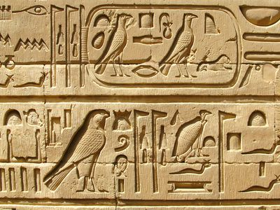
History of Cryptography and Simple Encryption Methods
The first known evidence of the use of cryptography (in some form) was found in an inscription carved around 1900 BC, in the main chamber of the tomb of the nobleman Khnumhotep II, in Egypt.
The scribe used some unusual hieroglyphic symbols here and there in place of more ordinary ones.
Hieroglyphic symbols may represent the objects that they depict but usually stand for particular sounds or groups of sounds.
19/03/2025
Mr. Wilbard G. Masue

Slide 21
History of Cryptography and Simple Encryption Methods
Claude E. Shannon. is considered by many to be the father of mathematical cryptography.
Shannon worked for several years at Bell Labs, and during his time there, he produced an article entitled "A mathematical theory of cryptography“.
19/03/2025
Mr. Wilbard G. Masue

Slide 22
History of Cryptography and Simple Encryption Methods
Fast forwarding to around 100 BC, Julius Caesar was known to use a form of encryption to convey secret messages to his army generals posted in the war front.
This substitution cipher, known as Caesar cipher, is perhaps the most mentioned historic cipher in academic literature.
A Caesar cipher is an algorithm used for encryption or decryption.
In a substitution cipher, each character of the plain text is substituted by another character to form the cipher text.
19/03/2025
Mr. Wilbard G. Masue

Slide 23
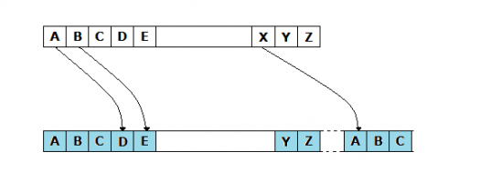
History of Cryptography and Simple Encryption Methods
The variant used by Caesar was a shift by 3 cipher.
Each character was shifted by 3 places, so the character 'A' was replaced by 'D', 'B' was replaced by 'E', and so on. The characters would wrap around at the end, so 'X' would be replaced by 'A’.
19/03/2025
Mr. Wilbard G. Masue

Slide 24
History of Cryptography and Simple Encryption Methods
It is easy to see that such ciphers depend on the secrecy of the system and not on the encryption key.
Once the system is known, these encrypted messages can easily be decrypted.
In fact, substitution ciphers can be broken by using the frequency of letters in the language known as brute force attack.
19/03/2025
Mr. Wilbard G. Masue

Slide 25
History of Cryptography and Simple Encryption Methods
During the 16th century, Vigenere designed a cipher that was supposedly the first cipher which used an encryption key.
In one of his ciphers, the encryption key was repeated multiple times spanning the entire message, and then the cipher text was produced by adding the message character with the key character modulo 26.
Modulo, or mod, is a mathematical expression in which you calculate the remainder of a division when one number is divided by another.
As with the Caesar cipher, Vigenere's cipher can also easily be broken; however, Vigenere's cipher brought the very idea of introducing encryption keys into the picture, though it was poorly executed.
Comparing this to Caesar cipher, the secrecy of the message depends on the secrecy of the encryption key, rather than the secrecy of the system.
19/03/2025
Mr. Wilbard G. Masue

Slide 26
History of Cryptography and Simple Encryption Methods
Vigenere cipher
The Vigenère cipher is a method of encrypting alphabetic text by using a series of fused Caesar ciphers, based on the letters of a keyword. It employs a form of polyalphabetic substitution
19/03/2025
Mr. Wilbard G. Masue

Slide 27
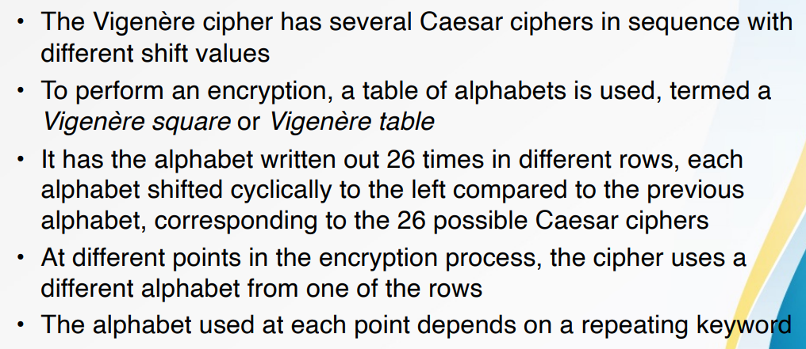
History of Cryptography and Simple Encryption Methods
Vigenere cipher
19/03/2025
Mr. Wilbard G. Masue

Slide 28
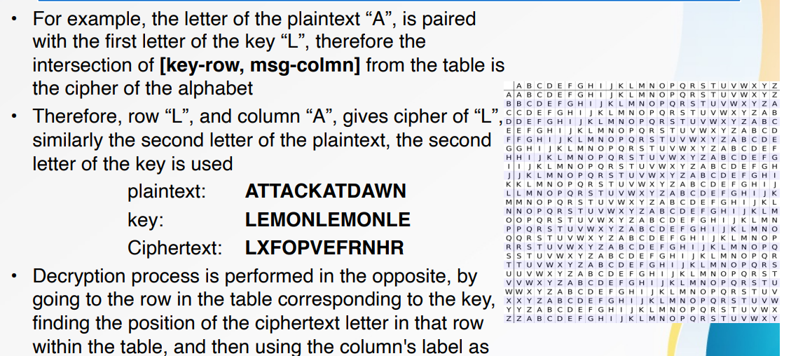
History of Cryptography and Simple Encryption Methods
Vigenere cipher
19/03/2025
Mr. Wilbard G. Masue

Slide 29
History of Cryptography and Simple Encryption Methods
At the start of the 19th century when everything became electric, Hebern designed an electro-mechanical contraption which was called the Hebern rotor machine.
It uses a single rotor, in which the secret key is embedded in a rotating disc.
The key encoded a substitution table and each key press from the keyboard resulted in the output of cipher text. This also rotated the disc by one notch and a different table would then be used for the next plain text character. This was again broken by using letter frequencies.
19/03/2025
Mr. Wilbard G. Masue

Slide 30
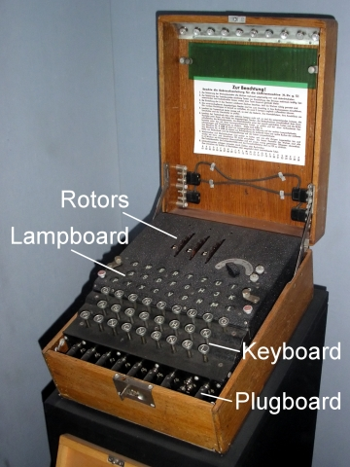
History of Cryptography and Simple Encryption Methods
19/03/2025
Mr. Wilbard G. Masue

Slide 31
History of Cryptography and Simple Encryption Methods
Up to the Second World War, most of the work on cryptography was for military purposes, usually used to hide secret military information.
However, cryptography attracted commercial attention post-war, with businesses trying to secure their data from competitors.
19/03/2025
Mr. Wilbard G. Masue

Slide 32
History of Cryptography and Simple Encryption Methods
In the early 1970's, IBM realized that their customers were demanding some form of encryption, so they formed a "crypto group" headed by Horst-Feistel.
They designed a cipher called Lucifer.
In 1973, the Nation Bureau of Standards (now called NIST) in the US put out a request for proposals for a block cipher which would become a national standard. They had obviously realized that they were buying a lot of commercial products without any good crypto support. .
19/03/2025
Mr. Wilbard G. Masue

Slide 33
History of Cryptography and Simple Encryption Methods
Lucifer was eventually accepted and was called DES or the Data Encryption Standard.
In 1997, and in the following years, DES was broken by an exhaustive search attack.
The main problem with DES was the small size of the encryption key.
As computing power increased it became easy to brute force all different combinations of the key to obtain a possible plain text message
19/03/2025
Mr. Wilbard G. Masue

Slide 34
History of Cryptography and Simple Encryption Methods
In 1997, NIST again put out a request for proposal for a new block cipher. It received 50 submissions. In 2000, it accepted Rijndael, and christened as AES or the Advanced Encryption Standard.
To conclude, history teaches us:
  The secrecy of your message should always depend on the secrecy of the key, and not on the secrecy of the encryption system. (This is known as Kerckhoffs's principle.)
  Related to the above, always use ciphers which have been publicly reviewed and have been established as a standard.
    Using "secret crypto" is bad, because just like the Caesar cipher, once the system is known, all messages can be decrypted. For example, if your key is compromised, an attacker could access your messages; however, if the attacker can compromise the crypto system itself, they can obtain the plain text of every message (not just for a single person) encrypted by that system.
19/03/2025
Mr. Wilbard G. Masue

Slide 35
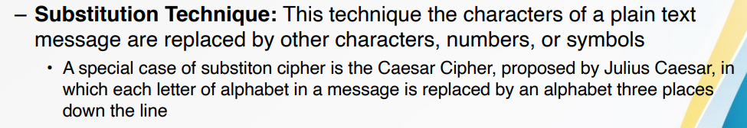
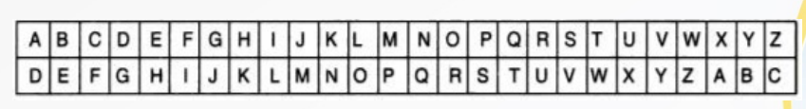
History of Cryptography and Simple Encryption Methods
There are two primary ways in which the plain text message can be codified to obtain the corresponding cipher text:
  Substitution and
  Transposition.
19/03/2025
Mr. Wilbard G. Masue

Slide 36
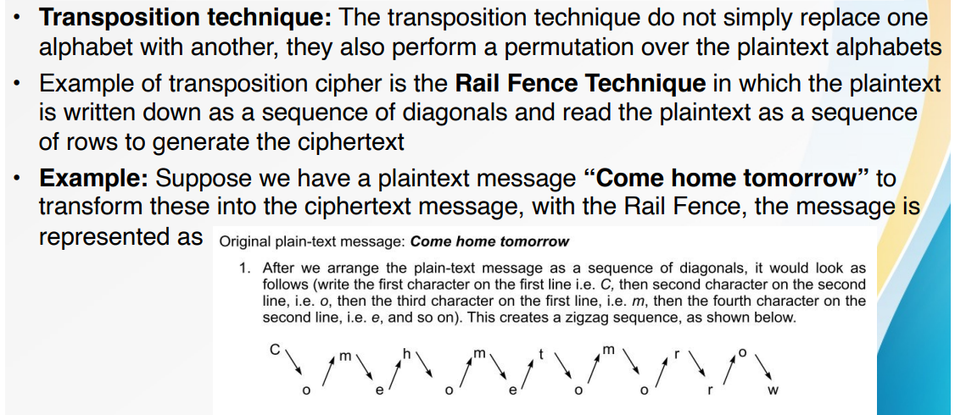

History of Cryptography and Simple Encryption Methods
19/03/2025
Mr. Wilbard G. Masue

Slide 37
History of Cryptography and Simple Encryption Methods
Modern Cryptography is the cornerstone of computer and communications security.
Its foundation is based on various concepts of mathematics such as
  number theory,
  computational-complexity theory, and
  probability theory.
19/03/2025
Mr. Wilbard G. Masue

Slide 38
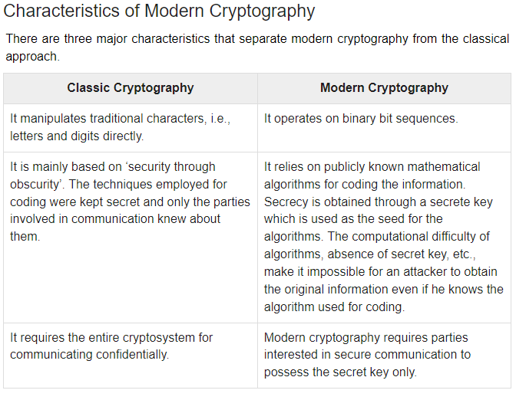
History of Cryptography and Simple Encryption Methods
19/03/2025
Mr. Wilbard G. Masue

Slide 39
Encryption
Security mechanisms are technical tools and techniques that are used to implement security services.
A mechanism might operate by itself, or with others, to provide a particular service.
Examples of common security mechanisms are as follows:
  Cryptography
  Message digests and digital signatures
  Digital certificates
  Public Key Infrastructure (PKI)
19/03/2025
Mr. Wilbard G. Masue

Slide 40
Cryptography Primitives (mechanism)
  Cryptography primitives are nothing but the tools and techniques in Cryptography that can be selectively used to provide a set of desired security services:-
    Encryption
    Hash functions
    Message Authentication codes (MAC)
    Digital Signatures
19/03/2025
Mr. Wilbard G. Masue

Slide 41
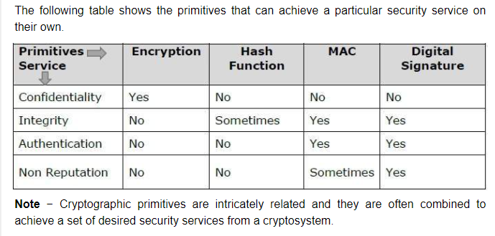
Encryption
19/03/2025
Mr. Wilbard G. Masue

Slide 42
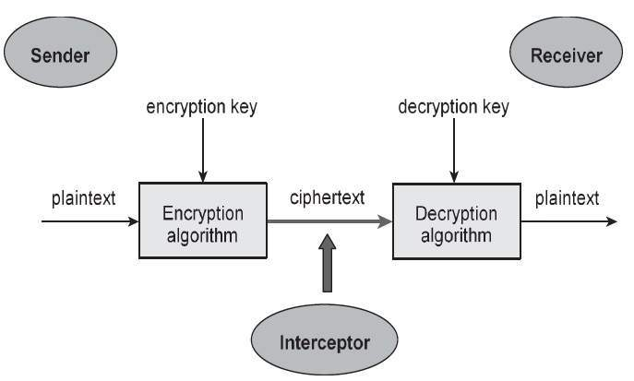
Encryption
19/03/2025
Mr. Wilbard G. Masue

Slide 43
Components of a Cryptosystem
The various components of a basic cryptosystem are as follows:-
  Plaintext.
  Ciphertext
  Encryption Algorithm
  Decryption Algorithm
  Encryption Key
  Decryption Key
  An interceptor (an attacker)
19/03/2025
Mr. Wilbard G. Masue

Slide 44
Components of a Cryptosystem
Plaintext. It is the data to be protected during transmission.
Encryption Algorithm. It is a mathematical process that produces a ciphertext for any given plaintext and encryption key. It is a cryptographic algorithm that takes plaintext and an encryption key as input and produces a ciphertext.
Ciphertext. It is the scrambled version of the plaintext produced by the encryption algorithm using a specific the encryption key. The ciphertext is not guarded. It flows on public channel. It can be intercepted or compromised by anyone who has access to the communication channel.
Decryption Algorithm, It is a mathematical process, that produces a unique plaintext for any given ciphertext and decryption key. It is a cryptographic algorithm that takes a ciphertext and a decryption key as input, and outputs a plaintext. The decryption algorithm essentially reverses the encryption algorithm and is thus closely related to it.
19/03/2025
Mr. Wilbard G. Masue

Slide 45
Components of a Cryptosystem
Encryption Key. It is a value that is known to the sender. The sender inputs the encryption key into the encryption algorithm along with the plaintext in order to compute the ciphertext.
Decryption Key. It is a value that is known to the receiver. The decryption key is related to the encryption key, but is not always identical to it. The receiver inputs the decryption key into the decryption algorithm along with the ciphertext in order to compute the plaintext.
For a given cryptosystem, a collection of all possible decryption keys is called a key space.
An interceptor (an attacker) is an unauthorized entity who attempts to determine the plaintext. He can see the ciphertext and may know the decryption algorithm. He, however, must never know the decryption key.
19/03/2025
Mr. Wilbard G. Masue

Slide 46
Types of Cryptosystems
Fundamentally, there are two types of cryptosystems based on the manner in which encryption-decryption is carried out in the system:-
  Symmetric Key Encryption
  Asymmetric Key Encryption
The main difference between these cryptosystems is the relationship between the encryption and the decryption key. Logically, in any cryptosystem, both the keys are closely associated. It is practically impossible to decrypt the ciphertext with the key that is unrelated to the encryption key.
19/03/2025
Mr. Wilbard G. Masue

Slide 47
Symmetric Key Encryption
  The encryption process where same keys are used for encrypting and decrypting the information is known as Symmetric Key Encryption.
  The study of symmetric cryptosystems is referred to as symmetric cryptography. Symmetric cryptosystems are also sometimes referred to as secret key cryptosystems.
  A few well-known examples of symmetric key encryption methods are − Digital Encryption Standard (DES), Triple-DES (3DES), IDEA, AES and BLOWFISH.
19/03/2025
Mr. Wilbard G. Masue

Slide 48
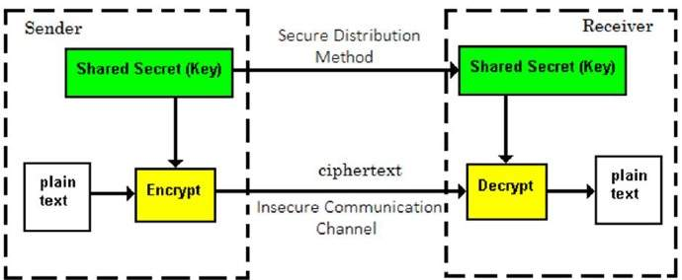
Symmetric Key Encryption
19/03/2025
Mr. Wilbard G. Masue

Slide 49
Symmetric Key Encryption
Some examples of symmetric encryption algorithms include:
  AES (Advanced Encryption Standard)
  DES (Data Encryption Standard)
  IDEA (International Data Encryption Algorithm)
  Blowfish (Drop-in replacement for DES or IDEA)
  RC4 (Rivest Cipher 4)
  RC5 (Rivest Cipher 5)
  RC6 (Rivest Cipher 6)
19/03/2025
Mr. Wilbard G. Masue

Slide 50
Challenge of Symmetric Key Cryptosystem
There are two restrictive challenges of employing symmetric key cryptography.
  Key establishment − Before any communication, both the sender and the receiver need to agree on a secret symmetric key. It requires a secure key establishment mechanism in place.
  Trust Issue − Since the sender and the receiver use the same symmetric key, there is an implicit requirement that the sender and the receiver ‘trust’ each other. For example, it may happen that the receiver has lost the key to an attacker and the sender is not informed.
These two challenges are highly restraining for modern day communication. Today, people need to exchange information with non-familiar and non-trusted parties. For example, a communication between online seller and customer.
These limitations of symmetric key encryption gave rise to asymmetric key encryption schemes.
19/03/2025
Mr. Wilbard G. Masue

Slide 51
Asymmetric Key Encryption
Asymmetric Key Encryption
The encryption process where different keys are used for encrypting and decrypting the information is known as Asymmetric Key Encryption.
Though the keys are different, they are mathematically related and hence, retrieving the plaintext by decrypting ciphertext is feasible. The process is depicted in the following illustration:-
19/03/2025
Mr. Wilbard G. Masue

Slide 52
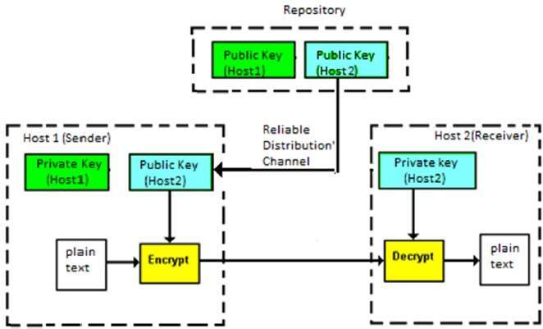
Asymmetric Key Encryption
19/03/2025
Mr. Wilbard G. Masue

Slide 53
Asymmetric Key Encryption
Asymmetric Key Encryption was invented in the 20th century to come over the necessity of pre-shared secret key between communicating persons. The salient features of this encryption scheme are as follows −
  Every user in this system needs to have a pair of dissimilar keys, private key and public key. These keys are mathematically related − when one key is used for encryption, the other can decrypt the ciphertext back to the original plaintext.
  It requires to put the public key in public repository and the private key as a well-guarded secret. Hence, this scheme of encryption is also called Public Key Encryption.
  Though public and private keys of the user are related, it is computationally not feasible to find one from another. This is a strength of this scheme.
  When Host1 needs to send data to Host2, he obtains the public key of Host2 from repository, encrypts the data, and transmits.
  Host2 uses his private key to extract the plaintext.
  Length of Keys (number of bits) in this encryption is large and hence, the process of encryption-decryption is slower than symmetric key encryption.
  Processing power of computer system required to run asymmetric algorithm is higher.
19/03/2025
Mr. Wilbard G. Masue

Slide 54
Asymmetric Key Encryption
Symmetric cryptosystems are a natural concept.
In contrast, public-key cryptosystems are quite difficult to comprehend.
You may think, how can the encryption key and the decryption key are ‘related’, and yet it is impossible to determine the decryption key from the encryption key?
The answer lies in the mathematical concepts.
It is possible to design a cryptosystem whose keys have this property. The concept of public-key cryptography is relatively new.
There are fewer public-key algorithms known than symmetric algorithms.
19/03/2025
Mr. Wilbard G. Masue

Slide 55
Challenge of Public Key Cryptosystem
Public-key cryptosystems have one significant challenge − the user needs to trust that the public key that he is using in communications with a person really is the public key of that person and has not been spoofed by a malicious third party.
This is usually accomplished through a Public Key Infrastructure (PKI) consisting a trusted third party. The third party securely manages and attests to the authenticity of public keys. When the third party is requested to provide the public key for any communicating person X, they are trusted to provide the correct public key.
The third party satisfies itself about user identity by the process of attestation, notarization, or some other process − that X is the one and only, or globally unique, X.
The most common method of making the verified public keys available is to embed them in a certificate which is digitally signed by the trusted third party.
19/03/2025
Mr. Wilbard G. Masue

Slide 56
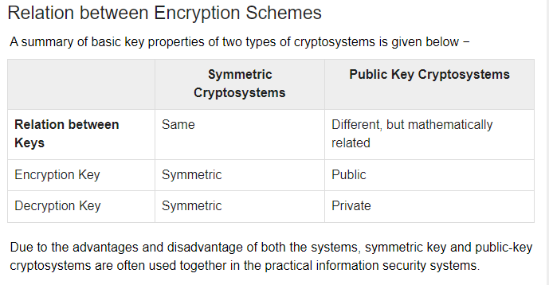
Encryption Schemes Relations
19/03/2025
Mr. Wilbard G. Masue

Slide 57
Kirchhoff's Principle for Cryptosystem
In the 19th century, a Dutch cryptographer A. Kerckhoff furnished the requirements of a good cryptosystem. Kerckhoff stated that a cryptographic system should be secure even if everything about the system, except the key, is public knowledge.
The six design principles defined by Kerckhoff for cryptosystem are −
  The cryptosystem should be unbreakable practically, if not mathematically.
  Falling of the cryptosystem in the hands of an intruder should not lead to any compromise of the system, preventing any inconvenience to the user.
  The key should be easily communicable, memorable, and changeable.
  The ciphertext should be transmissible by telegraph, an unsecure channel.
  The encryption apparatus and documents should be portable and operable by a single person.
  Finally, it is necessary that the system be easy to use, requiring neither mental strain nor the knowledge of a long series of rules to observe.
19/03/2025
Mr. Wilbard G. Masue

Slide 58
Kirchhoff's Principle for Cryptosystem
The second rule is currently known as Kerckhoff principle. It is applied in virtually all the contemporary encryption algorithms such as DES, AES, etc. These public algorithms are considered to be thoroughly secure. The security of the encrypted message depends solely on the security of the secret encryption key.
Keeping the algorithms secret may act as a significant barrier to cryptanalysis. However, keeping the algorithms secret is possible only when they are used in a strictly limited circle.
In modern era, cryptography needs to cater to users who are connected to the Internet. In such cases, using a secret algorithm is not feasible, hence Kerckhoff principles became essential guidelines for designing algorithms in modern cryptography.
19/03/2025
Mr. Wilbard G. Masue

Slide 59
Block cipher & Stream cipher
Stream ciphers encrypt one bit at a time, this can be very time-consuming and actually unnecessary in real life
Block ciphers is a symmetric key encrypt an entire block of plaintext bits at a time with the same key
  This means that the encryption of any plaintext bit in a given block depends on every other plaintext bit in the same block
  In practice, the vast majority of block ciphers either have a block length of 128 bits (16 bytes) such as the advanced encryption standard (AES), or a block length of 64 bits (8 bytes) such as DES.
19/03/2025
Mr. Wilbard G. Masue

Slide 60
Block cipher
Block ciphers are used more often in computer-based cryptographic algorithms as compared to stream ciphers
Consequently, block ciphers are performed with reference to their algorithm modes or operational modes.
However, two of the block-cipher algorithm modes can also be implemented as stream-cipher modes.
19/03/2025
Mr. Wilbard G. Masue

Slide 61
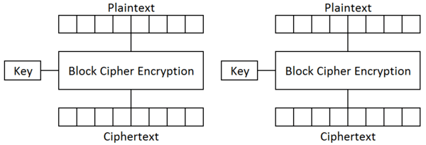
Block cipher
19/03/2025
Mr. Wilbard G. Masue

Slide 62
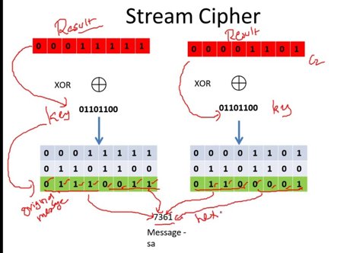
Stream cipher
19/03/2025
Mr. Wilbard G. Masue

Slide 63
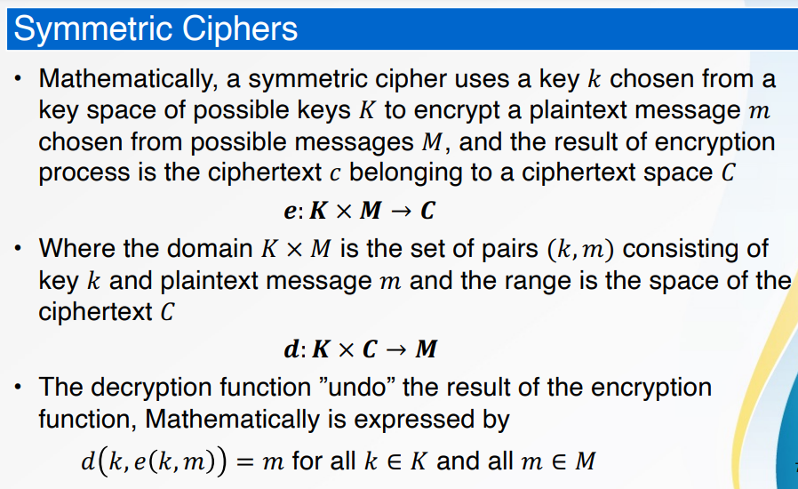
Symmetric Ciphers
19/03/2025
Mr. Wilbard G. Masue

Slide 64
Properties of Encryption Algorithms
Confusion & Diffusions: The concept of confusion and diffusion introduced by Claude Shannon plays significant role in computer-based cryptographic techniques
Confusion: Is the technique which ensures that a ciphertext message gives no clue about the original plaintext message
  The confusion tries to thwart the attempt of cryptanalyst to look for the patterns in the ciphertext so as to deduce the plaintext
  The confusion is achieved through substitution techniques – Diffusion: Increases the redundancy of plaintext by spreading it across rows and column
Diffusion means that if we change a single bit of the plaintext, then (statistically) half of the bits in the ciphertext should change, and similarly, if we change one bit of the ciphertext, then approximately one half of the plaintext bits should change
  The confusion is achieved through the transposition techniques (also called the permutation techniques)
Stream ciphers relies on confusion and block ciphers uses both confusion and diffusion.
19/03/2025
Mr. Wilbard G. Masue

Slide 65
Block Ciphers and Algorithms modes
  A block cipher processes the data blocks of fixed size
  Usually, the size of a message is larger than the block size
  The long message is divided into a series of sequential message blocks, and the cipher operates on these blocks one at a time
  An algorithm mode is a combination of a series of the basic algorithm steps on block cipher, and some kind of feedback from the previous step.
19/03/2025
Mr. Wilbard G. Masue

Slide 66
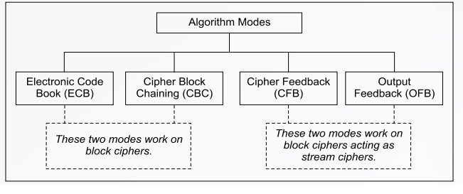
Block Ciphers and Algorithms modes
Block Ciphers and Algorithms modes
19/03/2025
Mr. Wilbard G. Masue

Slide 67
Cryptanalytic Attacks
There are various types of cryptanalytic attacks based on the amount of information known to the cryptanalyst.
Cipher text only – A copy of cipher text alone is known to the cryptanalyst.
Known plaintext – The cryptanalyst has a copy of the cipher text and the corresponding plaintext.
Chosen plaintext – The cryptanalysts gains temporary access to the encryption machine. They cannot open it to find the key, however; they can encrypt a large number of suitably chosen plaintexts and try to use the resulting cipher texts to deduce the key.
Chosen cipher text – The cryptanalyst obtains temporary access to the decryption machine, uses it to decrypt several string of symbols, and tries to use the results to deduce the key.
19/03/2025
Mr. Wilbard G. Masue

Slide 68
Classical Encryption Techniques
CAESAR CIPHER
The earliest known use of a substitution cipher and the simplest was by Julius Caesar. The Caesar cipher involves replacing each letter of the alphabet with the letter standing 3 places further down the alphabet. e.g., plain text : pay more money Cipher text: SDB PRUH PRQHB
Note that the alphabet is wrapped around, so that letter following „z‟ is „a‟.
For each plaintext letter p, substitute the cipher text letter c such that C = E(p) = (p+3) mod 26
A shift may be any amount, so that general Caesar algorithm is C = E (p) = (p+k) mod 26 Where k takes on a value in the range 1 to 25.
The decryption algorithm is simply P = D(C) = (C-k) mod 26
19/03/2025
Mr. Wilbard G. Masue

Slide 69
Classical Encryption Techniques
MONOALPHABETIC CIPHERS
Here, Plaintext characters are substituted by a different alphabet stream of characters shifted to the right or left by n positions. When compared to the Caesar ciphers, these monoalphabetic ciphers are more secure as each letter of the ciphertext can be any permutation of the 26 alphabetic characters leading to 26! or greater than 4 x 1026 possible keys. But it is still vulnerable to cryptanalysis, when a cryptanalyst is aware of the nature of the plaintext, he can find the regularities of the language. To overcome
these attacks, multiple substitutions for a single letter are used. For example, a letter can be substituted by different numerical cipher symbols such as 17, 54, 69….. etc. Even this method is not completely secure as each letter in the plain text affects on letter in the ciphertext.
Or, using a common key which substitutes every letter of the plain text.
19/03/2025
Mr. Wilbard G. Masue

Slide 70
Classical Encryption Techniques
PLAYFAIR CIPHERS
It is the best known multiple –letter encryption cipher which treats digrams in the plaintext as single units and translates these units into ciphertext digrams. The Playfair Cipher is a digram substitution cipher offering a relatively weak method of encryption. It was used for tactical purposes by British forces in the Second Boer War and in World War I and for the same purpose by the Australians and Germans during World War II. This was because Playfair is reasonably fast to use and requires no special equipment. A typical scenario for Playfair use would be to protect important but non-critical secrets during actual combat. By the time the enemy cryptanalysts could break the message, the information was useless to them. It is based around a 5x5 matrix, a copy of which is held by both communicating parties, into which 25 of the 26 letters of the alphabet (normally either j and i are represented by the same letter or x is ignored) are placed in a random fashion. For example, the plain text is Shi Sherry loves Heath Ledger and the agreed key is sherry.
Visit the link:
https://www.geeksforgeeks.org/playfair-cipher-with-examples/
https://www.youtube.com/watch?v=quKhvu2tPy8
19/03/2025
Mr. Wilbard G. Masue

Slide 71
Classical Encryption Techniques
Encryption rules: Playfair Cipher
Split the plaintext first into digraphs (pairs of two letters). If the plaintext has an odd number of letters, append the letter Z at the end. Even the text in the basic form of The MANGO plaintext, for instance, consists of five letters. Consequently, it is not possible to make a digraph. As a result, we will change the plaintext to MANGOZ by adding the letter Z at the end.
Divide the plaintext into digraphs after that (pair of two letters). For any letter that appears twice, place an X there (side by side). Think about the scenario where the digraph is CO MX MU NI CA TE and the plaintext is COMMUNICATE. For plaintext GREET, the digraph will be GR EX ET, but for plaintext JAZZ, the digraph will be JA ZX ZX.
To identify the cipher (encryption) text, create a 5*5 key-matrix or key-table and fill it with alphabetic letters as follows:
19/03/2025
Mr. Wilbard G. Masue

Slide 72
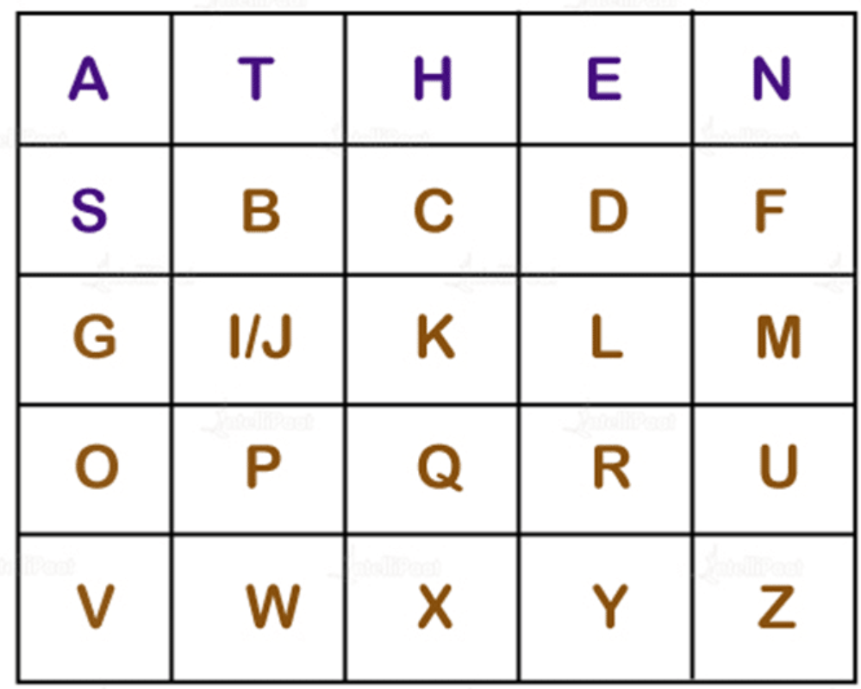
Classical Encryption Techniques
The first row, from left to right, should include the letters for the supplied keyword (ATHENS). If there are any duplicate letters in a keyword, avoid using them. This means a letter will only be taken into account once. Fill in the remaining letters alphabetically after that. Let’s create a 5*5 key-matrix for the keyword ATHENS.
19/03/2025
Mr. Wilbard G. Masue

Slide 73
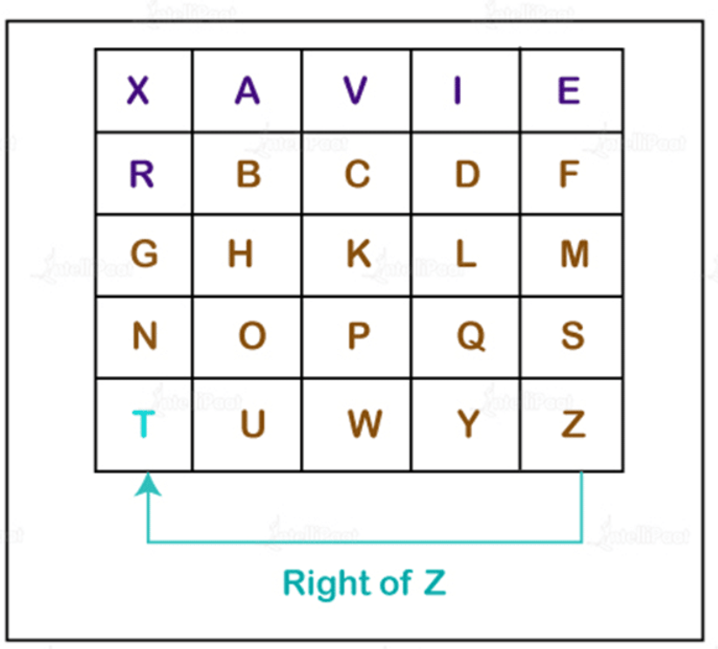
Classical Encryption Techniques
Remember that there are no duplicate letters in the above matrix. The first row of letters (in green) stands in for the keyword, while the remaining letter sets are organized alphabetically.
The following three scenarios are conceivable:
i) If two letters occur together in a row as a digraph, Each letter in the digraph, in this case, should be replaced with the letter that is immediate to its right. If there is no letter to the right, the first letter in the same row is considered to be the right letter. Assuming Z is a letter for which the appropriate letter is required, T will be the appropriate letter in this situation.
19/03/2025
Mr. Wilbard G. Masue

Slide 74
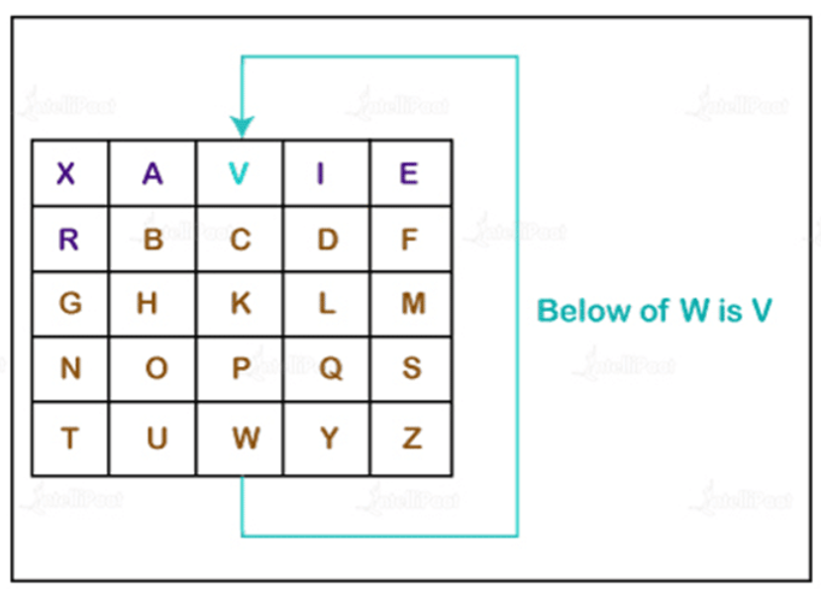
Classical Encryption Techniques
ii) If a pair of letters (digraph) appears in the same column
In this case, replace each letter of the digraph with the letters immediately below them. If there is no letter below, wrap around to the top of the same column. Suppose, W is a letter whose below letter is required, in such case, V will be below W.
19/03/2025
Mr. Wilbard G. Masue

Slide 75
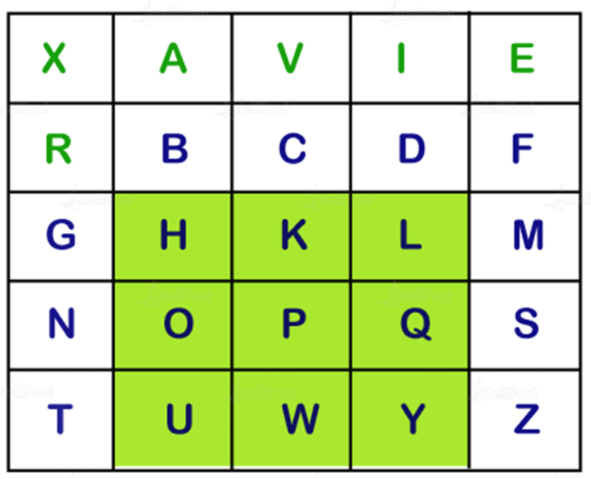
Classical Encryption Techniques
iii) In the event that a digraph (a pair of letters) is present in both its corresponding row and column:
To generate a cipher for a pair of letters within a 33 matrix, a 33 subset is selected from a larger 5*5 matrix. Specifically, two square corners within the matrix are chosen, which are positioned on opposite sides of a square. The remaining corner serves as the substitution for the given digraph.
19/03/2025
Mr. Wilbard G. Masue

Slide 76
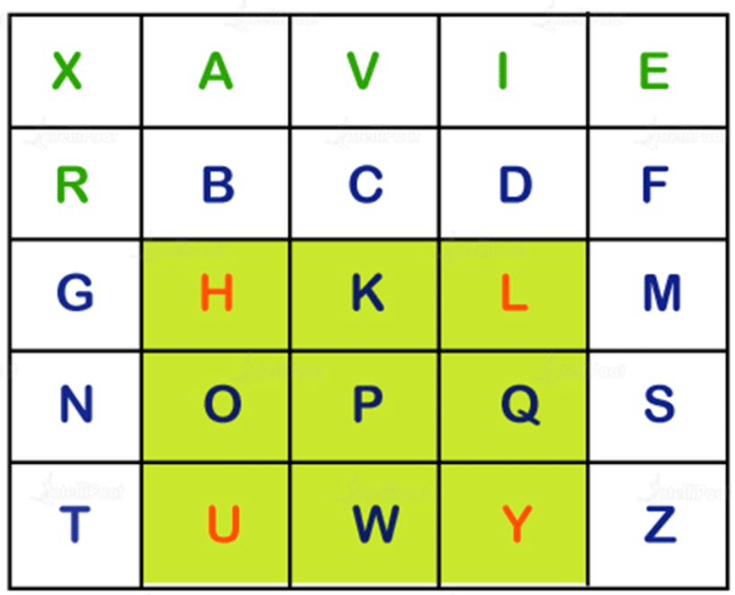
Classical Encryption Techniques
In simpler terms, the cipher for the first letter will be the intersection of the letters H and Y.
Let’s consider the scenario where we need to create a cipher for the digraph HY. As observed, both H and Y are situated in different rows and columns.
19/03/2025
Mr. Wilbard G. Masue

Slide 77
Play Fair Example
19/03/2025
Mr. Wilbard G. Masue

Slide 78
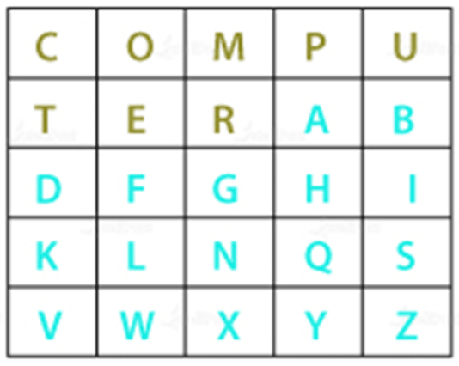
Classical Encryption Techniques
Playfair Cipher example
Assume “communication” is the plaintext and “computer” is the encryption key.
The key might be any word or phrase. Let’s figure out what was communicated.
1. First, create a digraph from the plaintext by applying rule 2, which is CO MX MU NI CA TE.
2. Make a key matrix that is 5 by 5. (by rule 3). The significant element in our circumstances is the computer.
3. We will now look through each key-matrix pair individually to find the corresponding encipher.
19/03/2025
Mr. Wilbard G. Masue

Slide 79
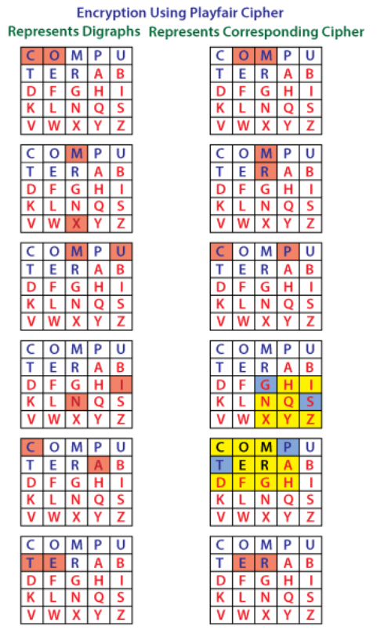
19/03/2025
Mr. Wilbard G. Masue

Slide 80
Classical Encryption Techniques
We will now look through each key-matrix pair individually to find the corresponding encipher.
The first digraph is CO. The two are displayed together in a row. The CO and OM are encrypted using Rule 4(i).
The second digraph is MX. Both of them are visible in the same column. The MX and RM are encrypted using Rule 4(ii).
The third digraph is MU. The two are displayed together in a row. MU is encrypted into the PC using Rule 4(i).
The fourth digraph is NI. The pair is visible in several rows and columns. NI is encrypted into SG using Rule 4(iii).
The sixth digraph is CA. The pair is visible in several rows and columns. Rule 4(iii) states are used by CA to encrypt data.
Therefore, the plaintext COMMUNICATE is encrypted using OMRMPCSGPTER.
19/03/2025
Mr. Wilbard G. Masue

Slide 81
Lab Assignment
Write a java/C++/python program that will be used to encrypt any message using any key and display its answer based on Playfair cipher.
Hints
  Use plaintext: BIRMINGHAM and
key: DIAMOND to test your program.
How do Cryptanalyst break this system of encryption?
19/03/2025
Mr. Wilbard G. Masue

Slide 82
Classical Encryption Techniques
HILL CIPHER
It is also a multi letter encryption cipher. It involves substitution of ‘m’ ciphertext letters for ‘m’ successive plaintext letters. For substitution purposes using ‘m’ linear equations, each of the characters are assigned a numerical values i.e. a=0, b=1, c=2, d=3,…….z=25. For example if m=3, the system can be defined as: c1 = (k11p1 + k12p2 + k13p3) mod 26 c2 = (k21p1 + k22p2 + k23p3) mod 26 c3 = (k31p1 + k32p2 + k33p3) mod 26 If we represent in matrix form, the above statements as matrices and column vectors:
19/03/2025
Mr. Wilbard G. Masue

Slide 83
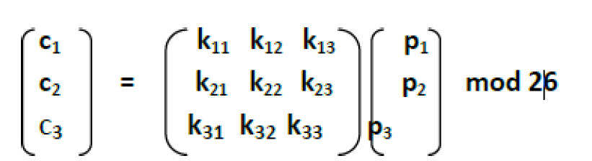
Classical Encryption Techniques
HILL CIPHER
Thus, C = KP mod26, where C= Column vectors of length 3 P = Column vectors of length 3.
K = 3x3 encryption key matrix. For decryption process, inverse of matrix K i.e. K⁻¹ is required which is defined by the equation KK⁻¹ = K⁻¹K = I, where I is the identity matrix that contains only 0’s and 1’s as its elements. Plaintext is recovered by applying K⁻¹ to the cipher text. It is expressed as
C = EK(P) = KP mod26
P = DK(C) = K⁻¹C mod26
K⁻¹KP = IP =P
19/03/2025
Mr. Wilbard G. Masue

Slide 84
Classical Encryption Techniques
POLYALPHABETIC CIPHERS
In order to make substitution ciphers more secure, more than one alphabet can be used. Such ciphers are called polyalphabetic, which means that the same letter of a message can be represented by different letters when encoded. Such a one-to-many correspondence makes the use of frequency analysis much more difficult in order to crack the code. We describe one such cipher named for Blaise de Vigenere a 16-th century Frenchman.
The Vigenere cipher is a polyalphabetic cipher based on using successively shifted alphabets, a different shifted alphabet for each of the 26 English letters. The procedure is based on the tableau shown below and the use of a keyword. The letters of the keyword determine the shifted alphabets used in the encoding process.
19/03/2025
Mr. Wilbard G. Masue

Slide 85
Classical Encryption Techniques
TRANSPOSITION TECHNIQUES
All the techniques examined so far involve the substitution of a cipher text symbol for a plaintext symbol. A very different kind of mapping is achieved by performing some sort of permutation on the plaintext letters. This technique is referred to as a transposition cipher.
Rail fence is simplest of such cipher, in which the plaintext is written down as a sequence of diagonals and then read off as a sequence of rows.
Row Transposition Ciphers-A more complex scheme is to write the message in a rectangle, row by row, and read the message off, column by column, but permute the order of the columns. The order of columns then becomes the key of the algorithm.
19/03/2025
Mr. Wilbard G. Masue

Slide 86
STEGANOGRAPHY
A plaintext message may be hidden in any one of the two ways.
The methods of steganography conceal the existence of the message, whereas the methods of cryptography render the message unintelligible to outsiders by various transformations of the text.
A simple form of steganography, but one that is time consuming to construct is one in which an arrangement of words or letters within an apparently innocuous text spells out the real message. e.g.,
  (i) the sequence of first letters of each word of the overall message spells out the real (hidden) message.
  (ii) Subset of the words of the overall message is used to convey the hidden message. Various other techniques have been used historically, some of them are
19/03/2025
Mr. Wilbard G. Masue

Slide 87
STEGANOGRAPHY
Drawbacks of Steganography
Requires a lot of overhead to hide a relatively few bits of information.
Once the system is discovered, it becomes virtually worthless.
19/03/2025
Mr. Wilbard G. Masue

Slide 88
STEGANOGRAPHY
Various other techniques have been used historically, some of them are:-
Character marking – selected letters of printed or typewritten text are overwritten in pencil. The marks are ordinarily not visible unless the paper is held to an angle to bright light.
Invisible ink – a number of substances can be used for writing but leave no visible trace until heat or some chemical is applied to the paper.
Pin punctures – small pin punctures on selected letters are ordinarily not visible unless the paper is held in front of the light.
Typewritten correction ribbon – used between the lines typed with a black ribbon, the results of typing with the correction tape are visible only under a strong light.
19/03/2025
Mr. Wilbard G. Masue

Slide 89
SEE YOU NEXT LECTURE
END
19/03/2025
Mr. Wilbard G. Masue

